Slide 1

BORROWIT
E-Asset Management
-Team Sudo Squad

Slide 2


Introduction
Site Name: BORROWIT
BorrowIT" is an E-Asset Management system designed to simplify the tracking, borrowing, and management of assets such as laptops, books, mobiles, and devices.
User-Friendly Interface: The user-friendly interface makes it easy for users to interact with the system, reducing the learning curve and ensuring a positive user experience.

Slide 3

Team Members
Archika Dixit
Arshiya Kaul
Ayushi Saxena
Divya Sharma
Nishant Dalai
Rashi Gupta
Rishav Chaudhary
Rishav Wadhwa

Slide 4

Problem Statement
Inefficient Borrowing Process
Manual Tracking
Data Inaccuracy
Asset Availability
Asset Misplacement and Loss
Lack of Accountability

Slide 5
Inefficient Borrowing Process: The current asset borrowing and return process lacks efficiency and transparency, causing delays and administrative bottlenecks.
Manual Asset Tracking: Administrators currently rely on manual methods for tracking and managing assets within the organization. This process is time-consuming, prone to errors, and lacks real-time visibility into asset availability and location.
Data Inaccuracy: Admins often deal with inaccurate asset data due to manual record-keeping, making it difficult to make informed decisions and report on asset status.

Slide 6
Asset Availability: Efficient asset availability, including real-time status updates, reservation conflict resolution, and borrower accountability, is a pressing challenge in asset management for organizations and individuals.
Asset Misplacement and Loss: The manual nature of asset tracking often results in assets being misplaced or lost, leading to additional costs and disruptions in operations.
Lack of Accountability: Ensuring accountability for asset usage and timely returns is challenging. Without proper tracking, it's difficult to hold users responsible for assets they borrow.

Slide 7

Overview
GOALS
Efficient Asset Management
Real-time Visibility
Data Accuracy
Scalability
User-Friendly Interface
Learning Experience

Slide 8

Features
Admin maintains both seller and borrower
Asset Categorization
Price Range and Sorting
Search and Filtering
Calendar view
Product status

Slide 9

User Interface (UI)

Slide 10
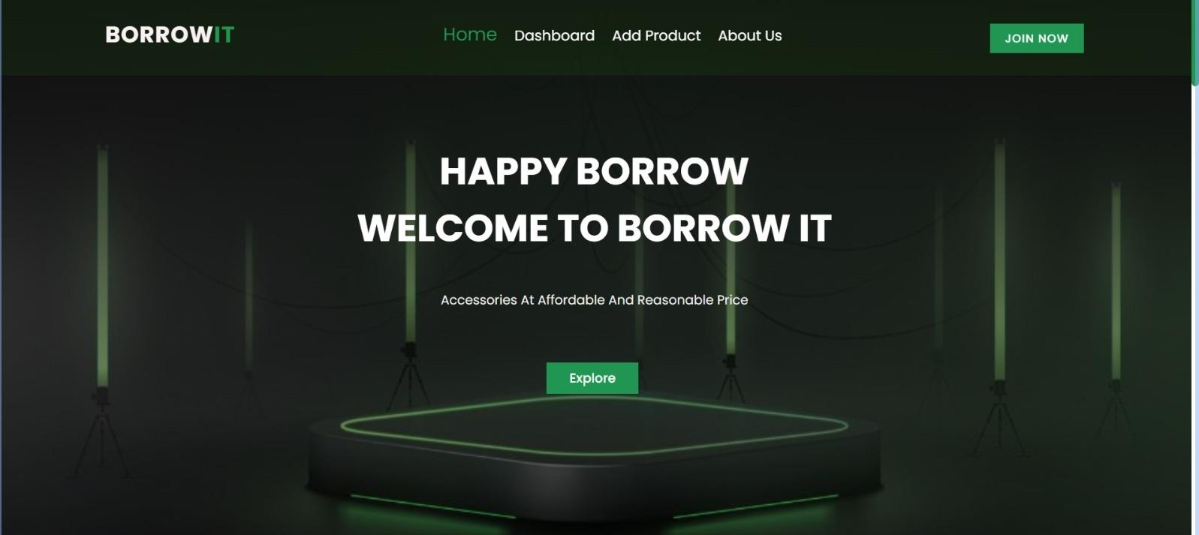
Home Page UI
Sleek and Stylish
Responsive Design
Easy on the Eye
Well-Executed

Slide 11
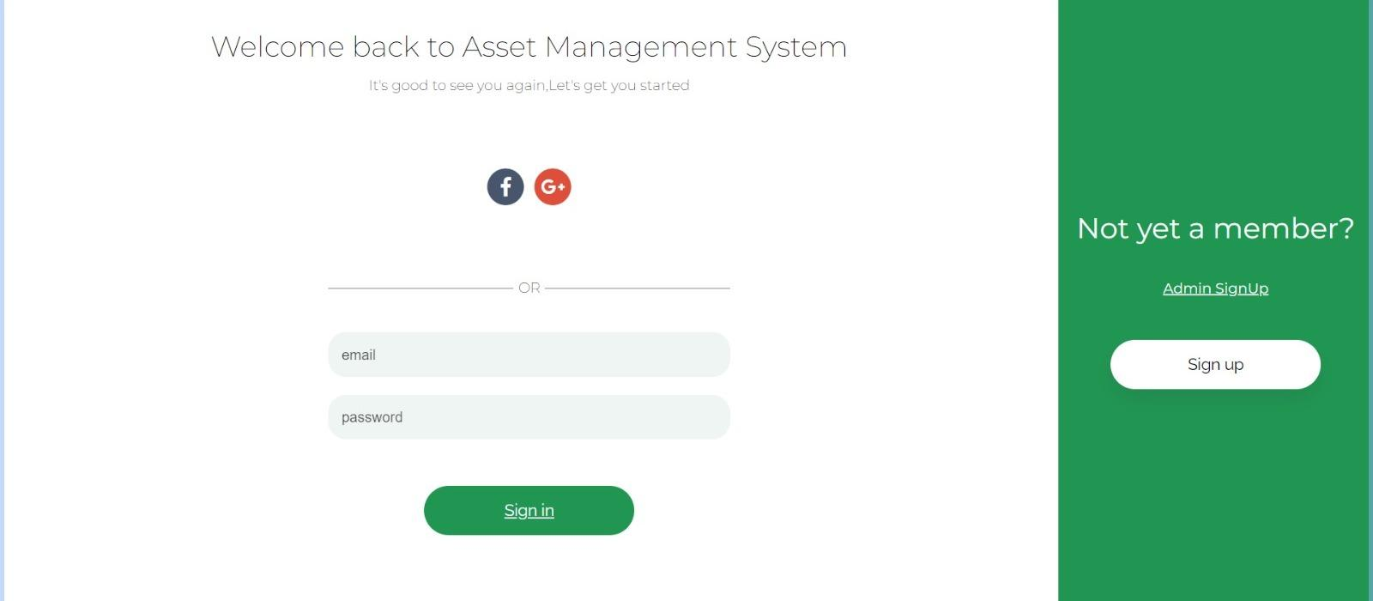
Login for Users
Admin sign up
Options for logging in (Facebook, Gmail)

Slide 12
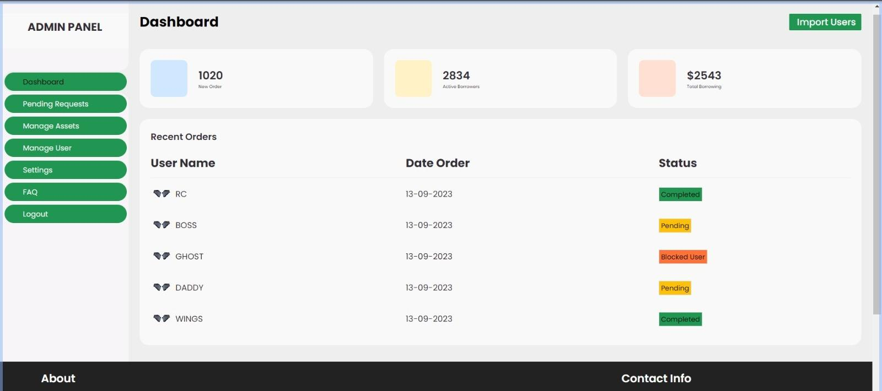
Admin Dashboard
Admin controls borrower and lender
View pending requests
Import users
Categorize the status
Manage Users
Manage Assets

Slide 13
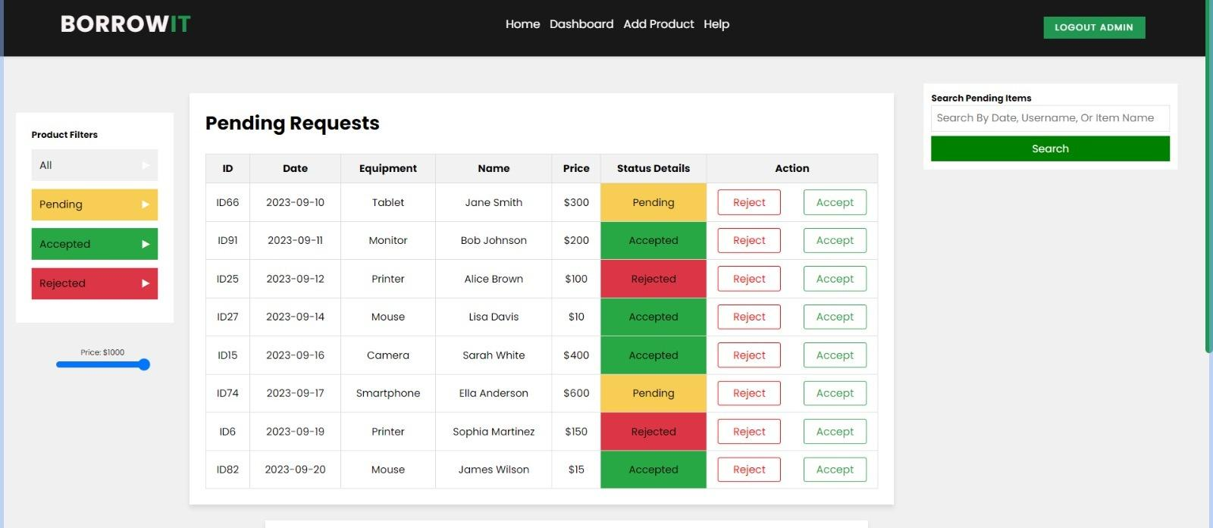
Pending Requests
Product filters
Scroll bar for price range

Slide 14
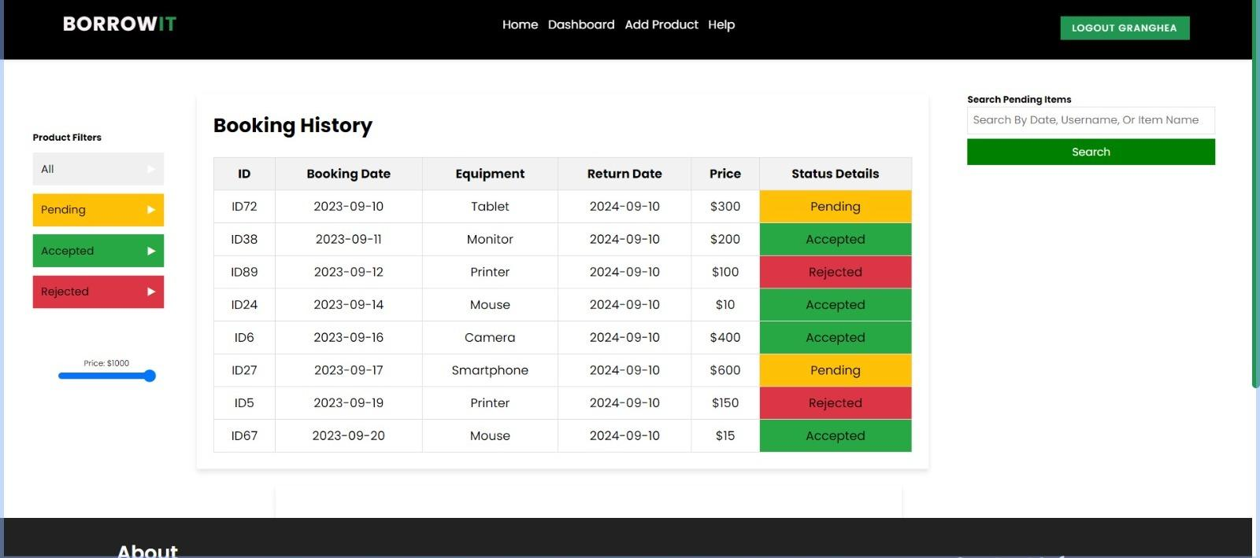
Booking request

Slide 15
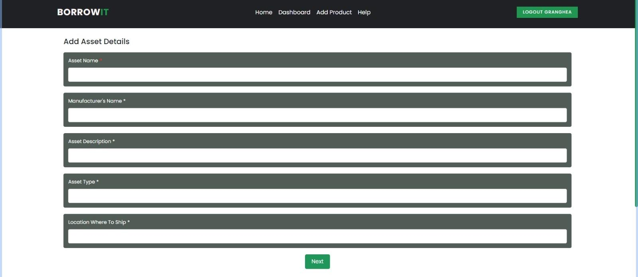
Asset Details by lender/seller

Slide 16
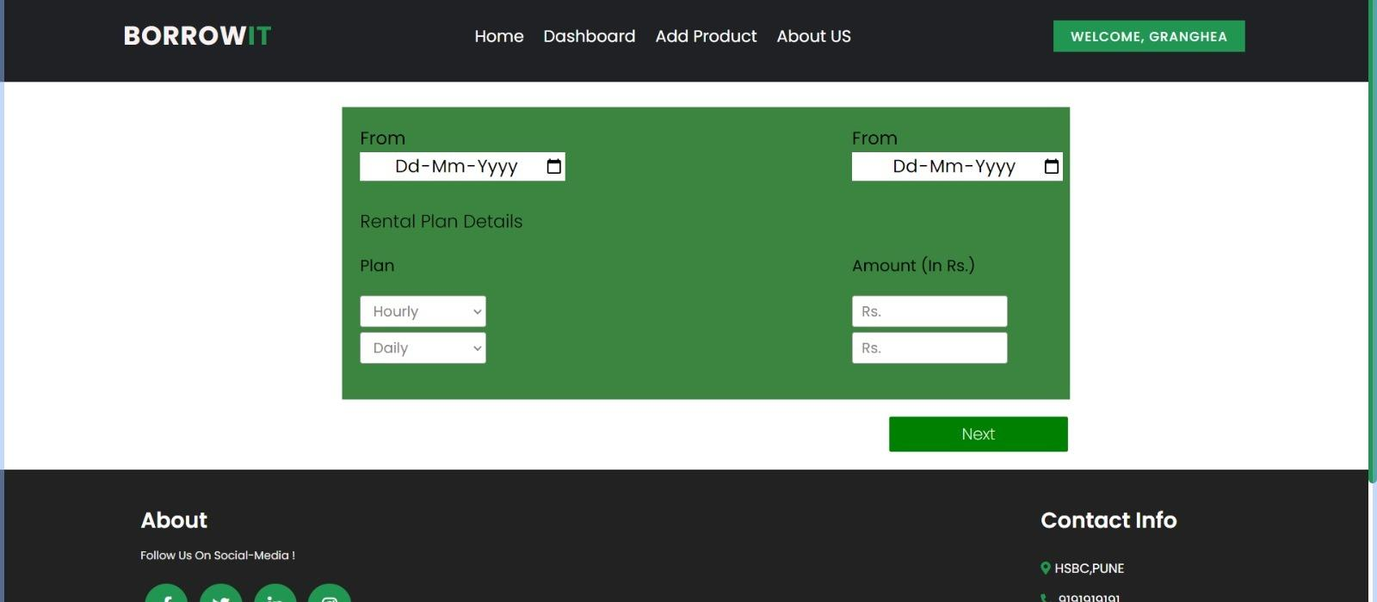
Asset Details

Slide 17
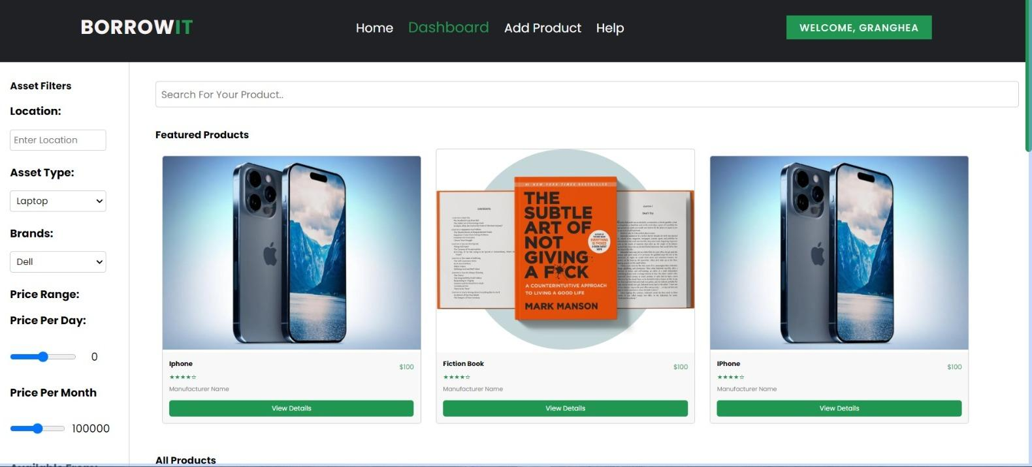
Dashboard

Slide 18
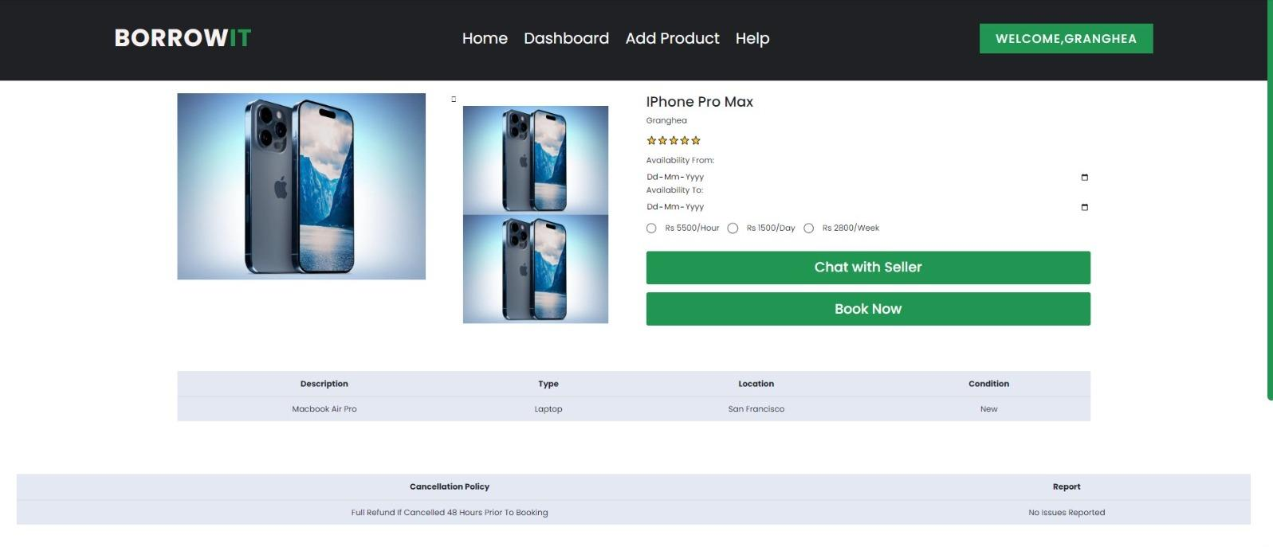
Asset details

Slide 19
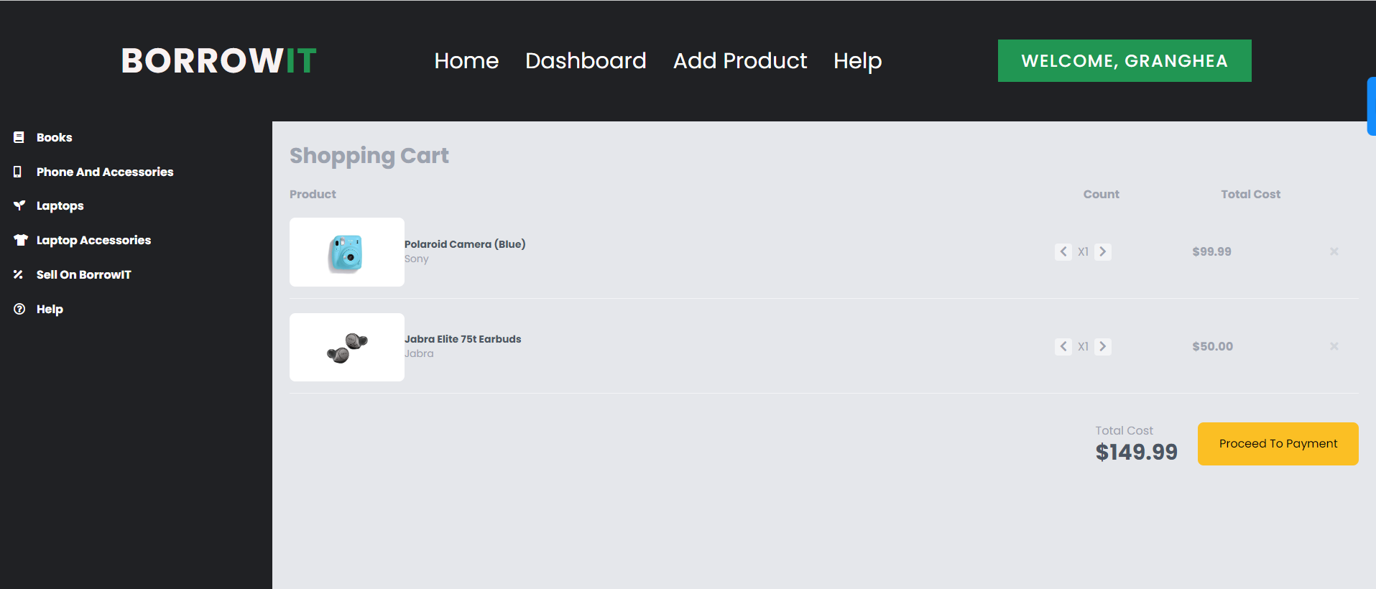
My Cart

Slide 20
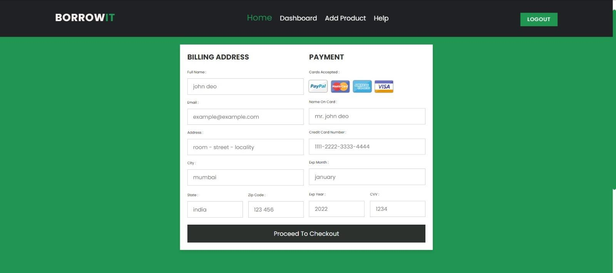
Transaction Page

Slide 21

Tools and Technology
HTML
CSS
Javascript
MYSQL
STS
JDBC

Slide 22
THANK YOU!

